Slide 1
WhiskerWatch
Presented by Team WW
Leon B., Joshua H., Jolie H., Ramim T.
Date 03/05/2024
Notes:
Introduce who we are, what our roles are (work split evenly), etc.

Slide 2



What and Why
An easy way to schedule a pet sitter!
(cats or dogs only :) )
When you have to go on a business trip/vacation, or just don’t have time in your schedule
Personalized marketing
Behavioral insights
Cross-promotion opportunities
Notes:
Business idea:
Have an easy way to schedule either a cat or dog-sitter
Why do you need it:
During times when you have to go on a business trip, vacation, or just have no time in your schedule.
Why will someone want to buy your business’s data to sell ads:
Charge a booking fee
Personalized marketing: advertisers can create personalized marketing campaigns that resonate with pet owners on a more individual level. They can use targeted messaging and offers based on pet owner demographics, pet types, and specific scheduling preferences.
Behavioral insights: valuable insights into the behaviors and habits of pet owners. Advertisers can use this information to understand consumer trends, such as popular pet care services, preferred pet products, and common scheduling patterns for pet sitting services.
Cross-Promotion Opportunities: Advertisers may also see opportunities for cross-promotion with other pet-related products or services. A pet food company might want to advertise their products to users who frequently schedule pet sitting services, knowing they are likely to have pets and need pet-related products.

Slide 3
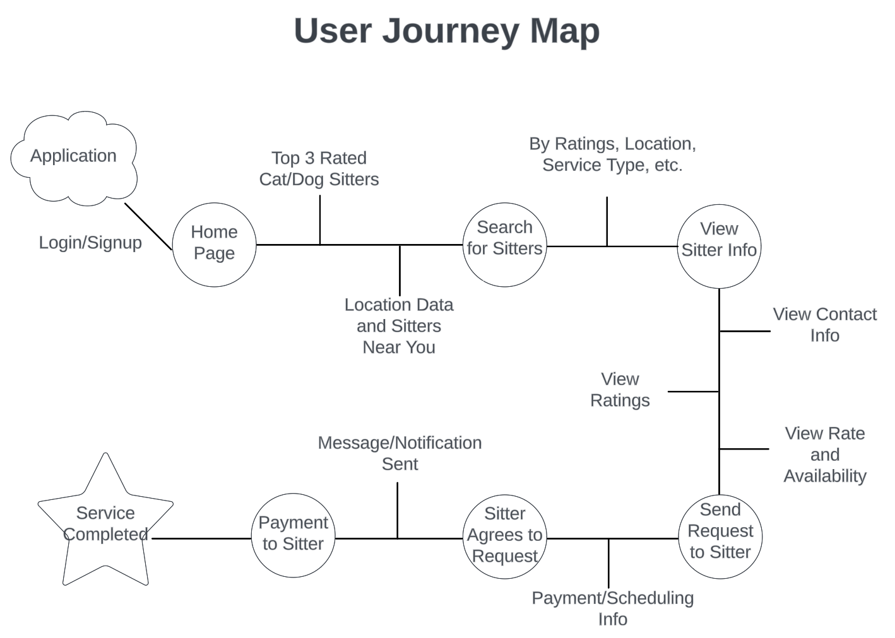
User’s Journey
Notes:
This is the use cases: we want to basically visualize what our product is so he can see
Explain how when the sitter signs up, they will need to set their rate and availability (even tho imo their rate should vary based on the job cause if someone has more animals they will want to be paid more)

Slide 4
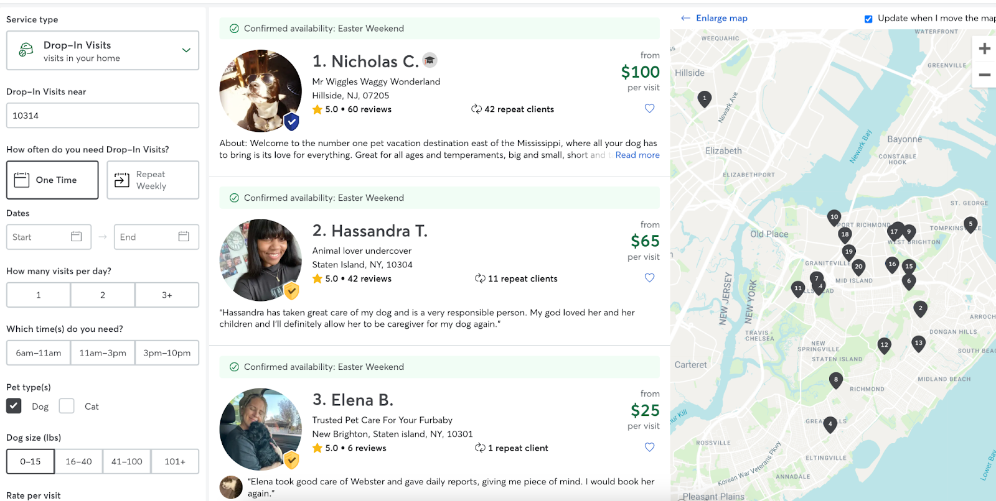
Mockup: Available sitters

Slide 5

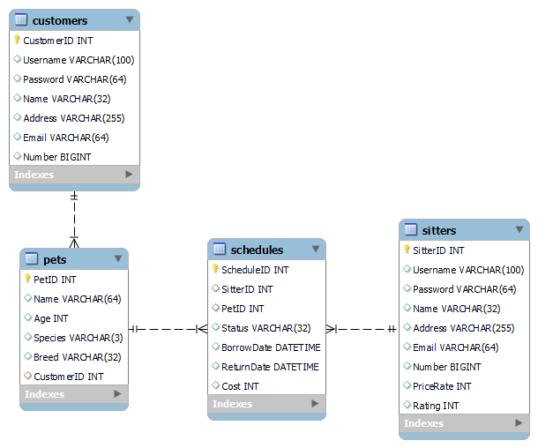
Relational Data Model
Notes:
Service fees added to sitters’ price rates (doordash)
“Cost” in schedules
Sell the data to make a profit
Companies would want to buy our data because we will know who owns dogs/cats and we will have their contact info. Meaning these companies can contact these users and send specialized advertisements/offers

Slide 6




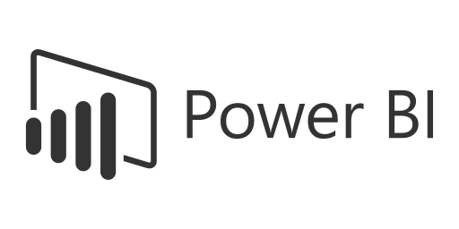
The Stack
Database:
Front-end:
Back-end:
Code Repository:
Reporting/Dashboard:
Notes:
Database Management System: MySQL
MySQL was chosen for its robustness, ease of use, and widespread adoption, which ensures reliable data management for our application.
Front-end Interface: React.js
React.js was chosen because of how it allows for effective code reusability through its component-based architecture. Our team also has prior experience from past projects using React.js.
Back-end: Flask (python)
Flask was chosen because of its simplicity, flexibility, and scalability. This rapid development of RESTful APIs and seamless integration with other Python libraries for various functionalities.
Code Repository: GitHub (individual repositories for each member) or similar
GitHub was chosen for its collaborative features, version control capabilities, and widespread adoption in the developer community. This ensures efficient code management and collaboration among our team members.
Reporting/Dashboard: Excel, PowerBI, or Google Data Studio
Lastly, for now, we chose PowerBI for its powerful data visualization capabilities, seamless integration with various data sources including MySQL. We also chose PowerBI because we want to gain more experience using this tool. We also have Excel and Google Data Studio as our 2nd/3rd options if we decide to not use PowerBI.

Slide 7
Member Roles
Project Managers: Leon & Ramim
Front-end: Leon & Ramim
UI/UX: Leon, Ramim, & Jolie
Back-end: Josh & Jolie
Reporting/Dashboard: Jolie & Josh
Notes:
Database Management System: MySQL
MySQL was chosen for its robustness, ease of use, and widespread adoption, which ensures reliable data management for our application.
Front-end Interface: React.js
React.js was chosen because of how it allows for effective code reusability through its component-based architecture. Our team also has prior experience from past projects using React.js.
Back-end: Flask (python)
Flask was chosen because of its simplicity, flexibility, and scalability. This rapid development of RESTful APIs and seamless integration with other Python libraries for various functionalities.
Code Repository: GitHub (individual repositories for each member) or similar
GitHub was chosen for its collaborative features, version control capabilities, and widespread adoption in the developer community. This ensures efficient code management and collaboration among our team members.
Reporting/Dashboard: Excel, PowerBI, or Google Data Studio
Lastly, for now, we chose PowerBI for its powerful data visualization capabilities, seamless integration with various data sources including MySQL. We also chose PowerBI because we want to gain more experience using this tool. We also have Excel and Google Data Studio as our 2nd/3rd options if we decide to not use PowerBI.

Slide 8
Q&A
Notes:
2 min for questions

